Slide 1
Duke Classification: with “2D-picture”
Yuhui Cao
20220816 Tue

Slide 2
Roadmap
Part 1. Convert Threshold to “2D picture”
Part 2. Shallow Neural Network (SNN)
- Train on Duke (400)
- Validate on Duke (100)
- Test on UAB (301)
Part 3: Transfer study of VGG16
- Train on Duke (400)
- Validate on Duke (100)
- Test on UAB (301)1a
Method 1 - pad with 0
Method 2 – Up-sample smaller img

Slide 3
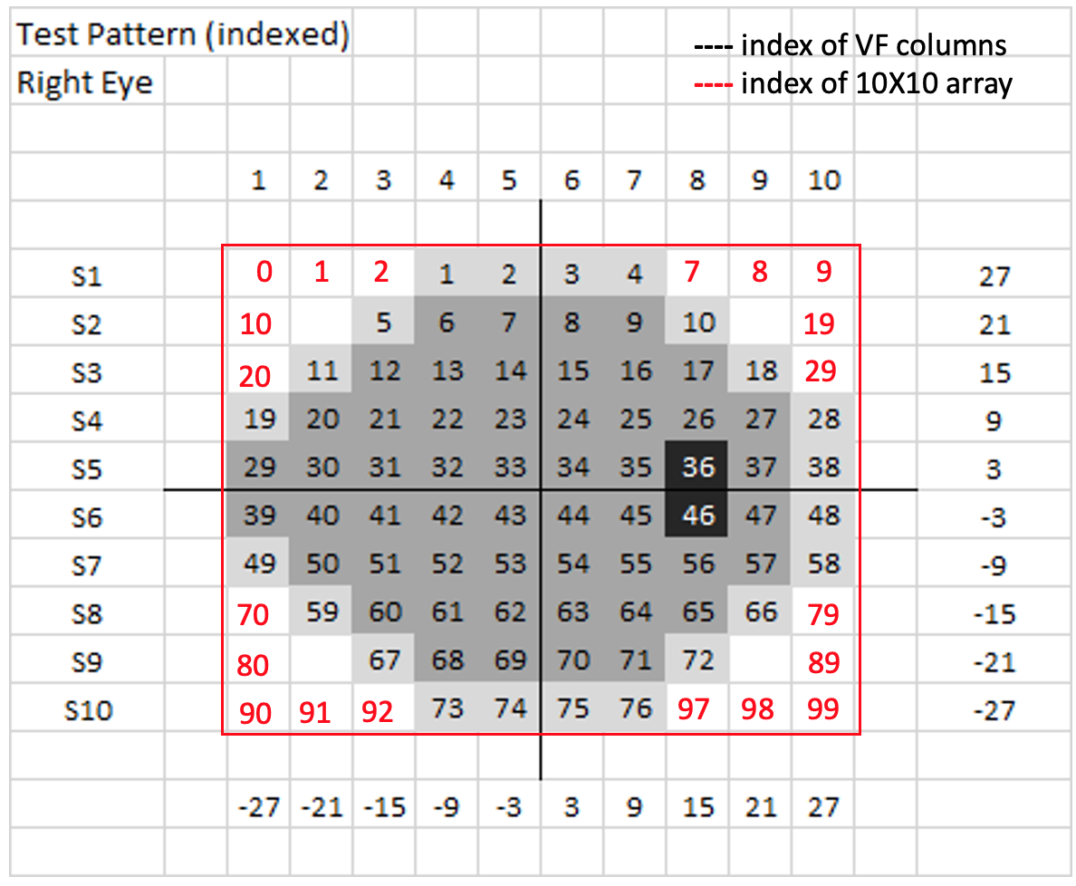
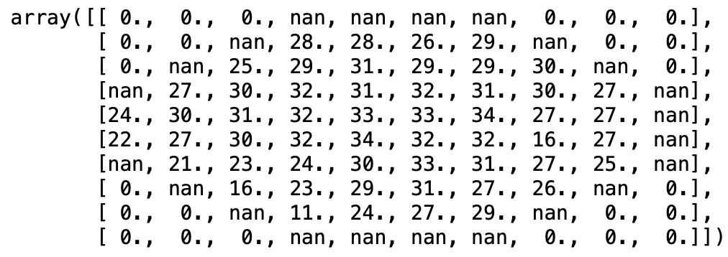
Part 1. Convert Threshold to “2D picture”
Yuhui:
Fill the rest of (100-76 =) 24 locations with 0?
Fill NaN of 24-2 with 0?

Slide 4
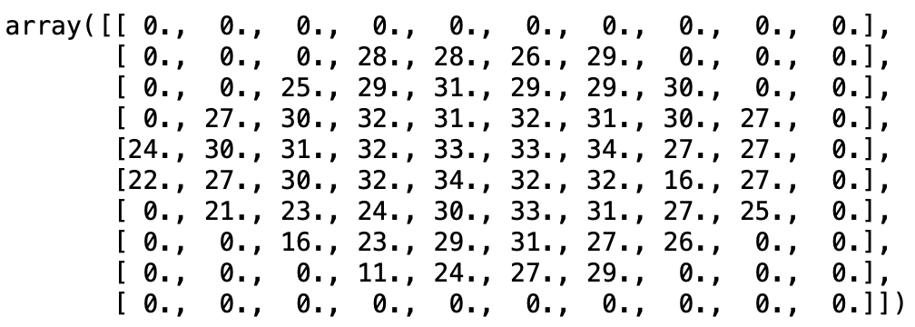
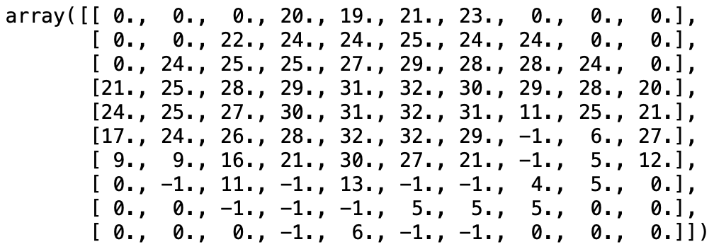
Part 1. Convert Threshold to “2D picture”
An example of 24-2
An example of 30-2
500 cases:
The number of 30-2 pattern is: 14
The number of 24-2 pattern is: 486

Slide 5
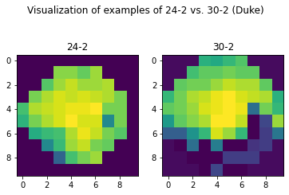
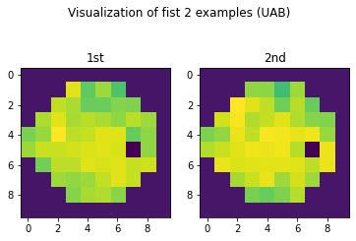
Part 1. Convert Threshold to “2D picture”
500 Duke
301 UAB

Slide 6
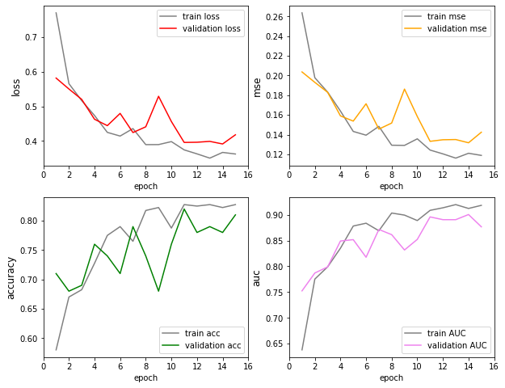
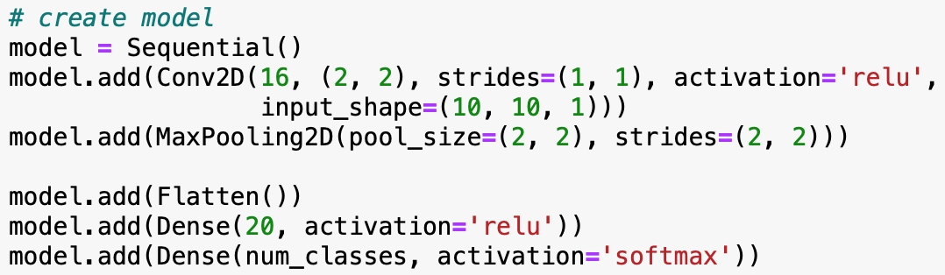
Part 2. Shallow Neural Network (SNN) Classification on normal vs. abnormal
SNN 1
epochs = 15
batch_size=30

Slide 7
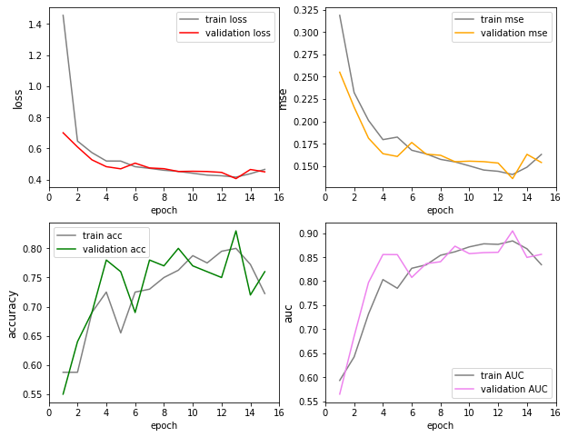
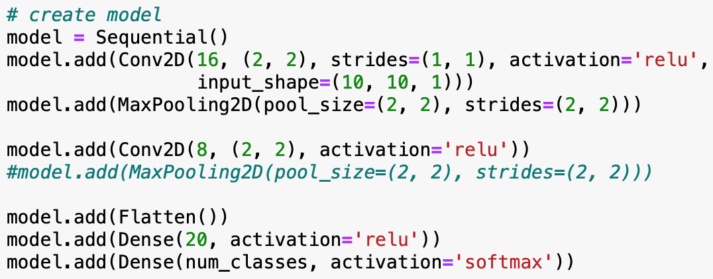
Part 2. Shallow Neural Network (SNN) Classification on normal vs. abnormal
SNN 2
epochs = 15
batch_size=30

Slide 8
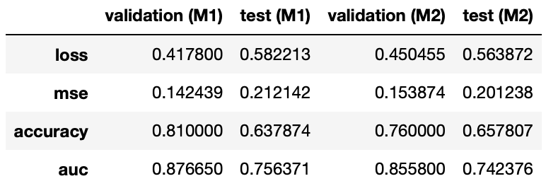
Part 2. Shallow Neural Network (SNN) Classification on normal vs. abnormal
Validation on Duke (100)
Test on UAB (301)
model1.save("SNN_1.h5")
model2.save("SNN_2.h5")

Slide 9
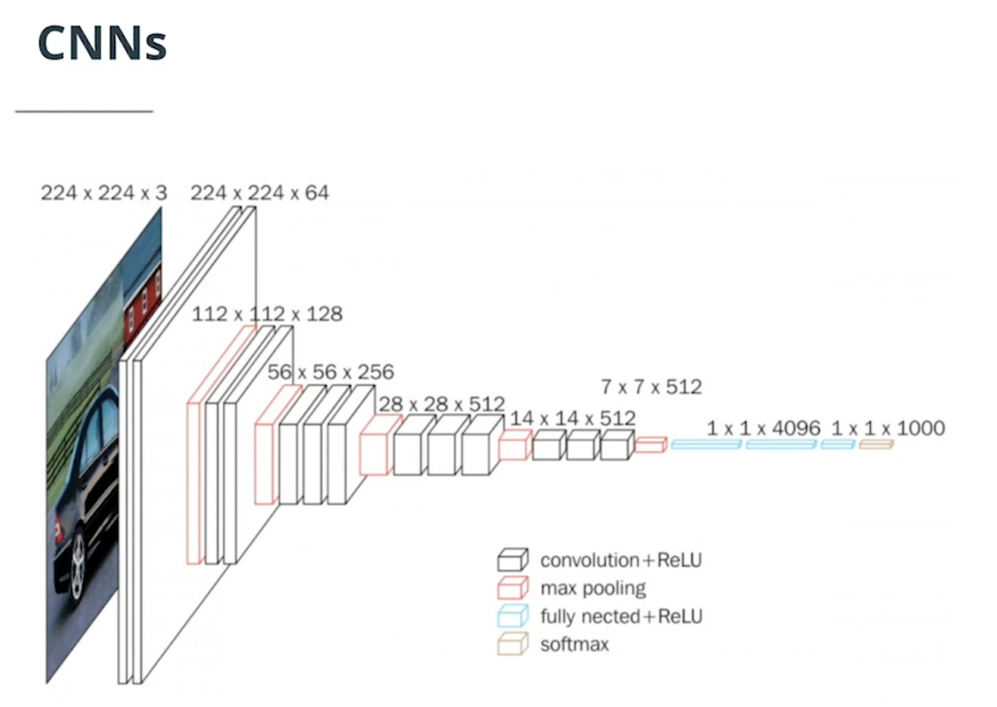
Part 3: Transfer study of VGG16
Yuhui strategies:
Should I start from 14X14X512 layer? (can very easily pad 10X10 to 14X14)
Resize 10X0 to 224X224 so that can use earlier layer? (preferred)

Slide 10
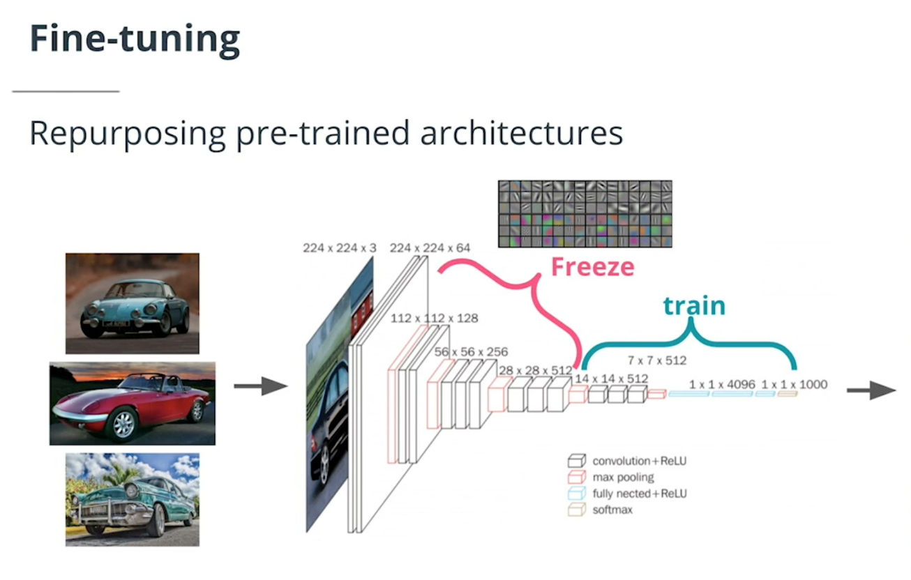
Part 3: Transfer study of VGG16

Slide 11
Dimension construction: resize to 224 X 224
Part 3: Transfer study of VGG16
1. 10 X 10
2. 224 X 224
3. 224 X 224 X 3
- repeat thr 3 times
- future: use thr, TD, PD
4. 500 X 224 X 224
Method 1 - pad with 0
Method 2 – Up-sample smaller img
Method 3 – Interpolating smaller img

Slide 12
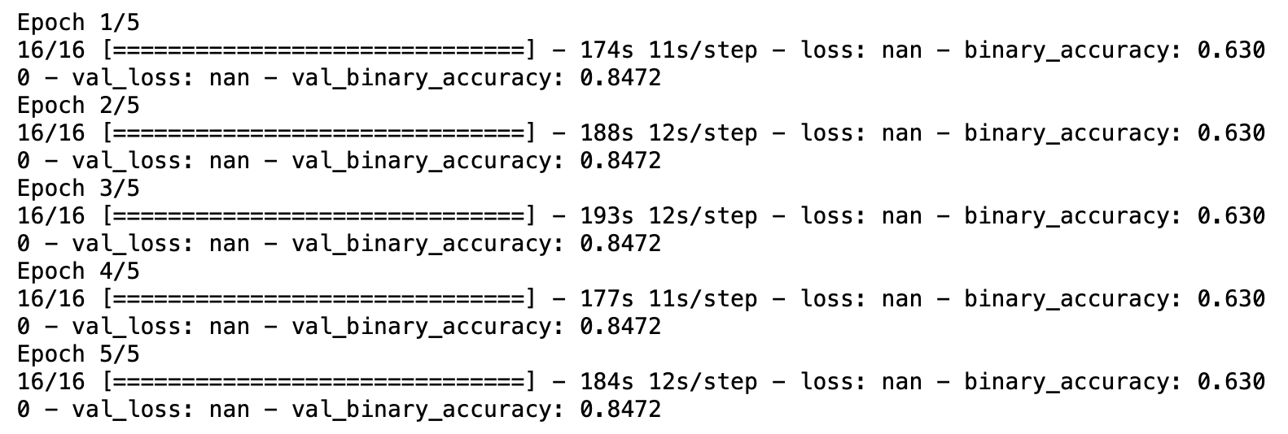
Result 0. Pad with NaN is not better ~

Slide 13
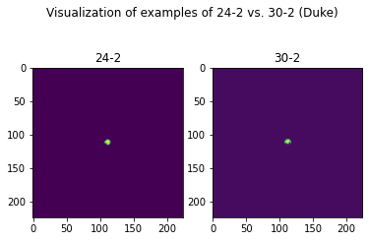
Result 1. Method 1 - pad with 0
Model 1: a simple sequential model using only the VGG16 architecture
Model 2: add a few more dense layers
Model 3: add dropout and another fully connected layer
Image Visualization

Slide 14
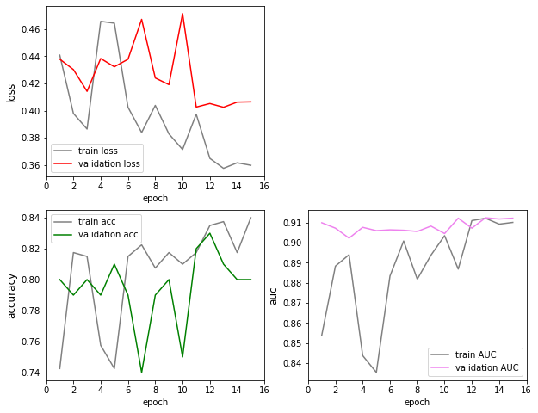
Part 3: Transfer study of VGG16 – model 1
epochs = 15
batch_size = 32 (default)

Slide 15
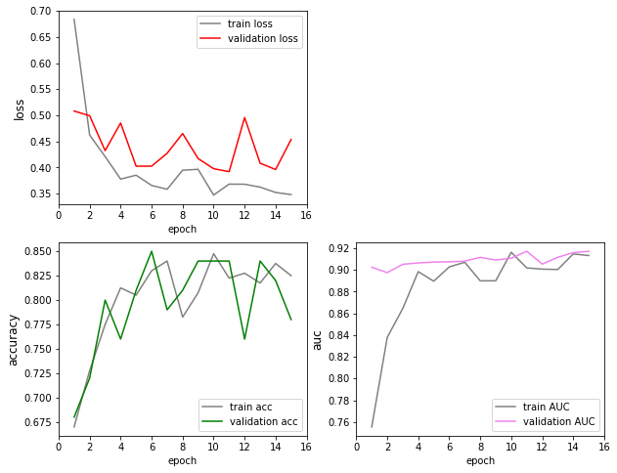
Part 3: Transfer study of VGG16 – model 2
epochs = 15
batch_size = 32 (default)

Slide 16
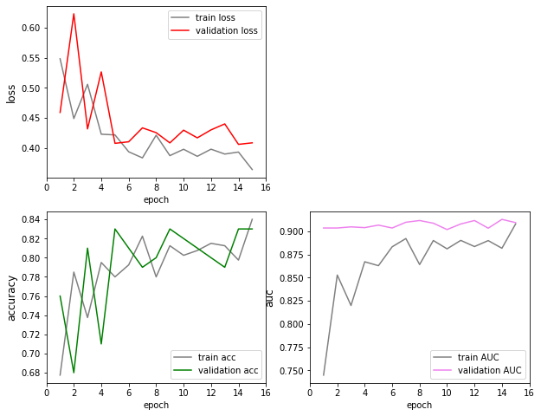
Part 3: Transfer study of VGG16 – model 3
epochs = 15
batch_size = 32 (default)

Slide 17
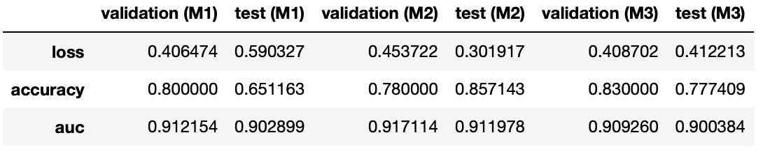
Test: Method 1 - pad with 0 (on UAB)
Validation on Duke (100)
Test on UAB (301)
model1.save("VGG1.h5")
model2.save("VGG2.h5")
model3.save("VGG3.h5")

Slide 18
Result 2. Method 2 – Up-sample smaller img
Model 1: a simple sequential model using only the VGG16 architecture
Model 2: add a few more dense layers
Model 3: add dropout and another fully connected layer

Slide 19
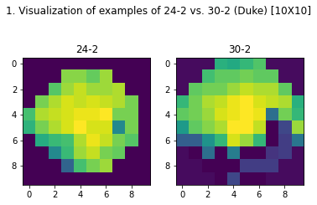
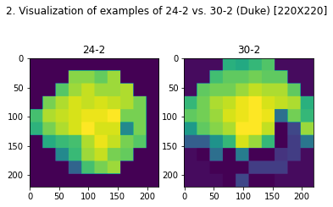

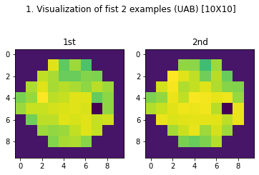
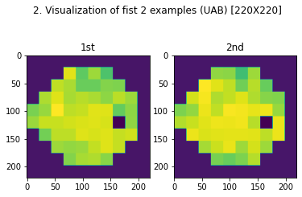
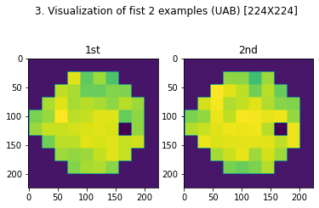
Image Visualization

Slide 20
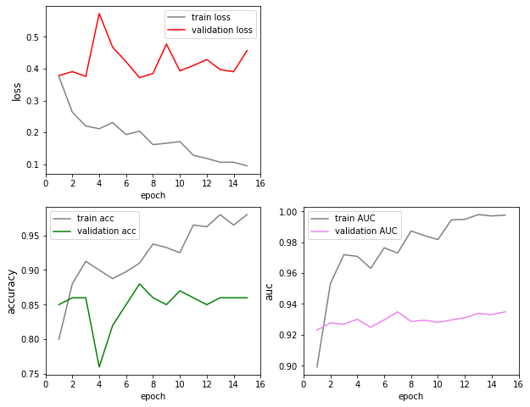
Model 1
Notes:
Model 1

Slide 21
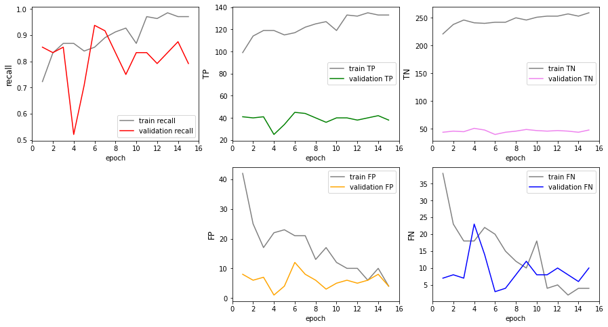
Model 1

Slide 22
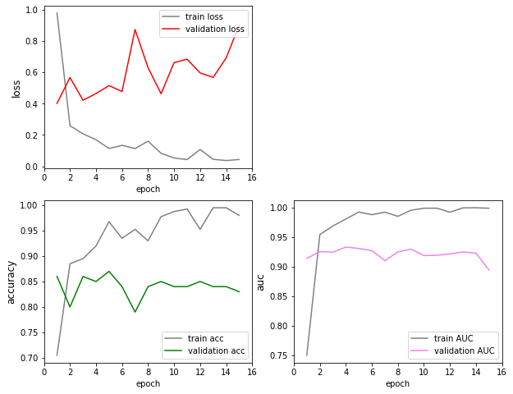
Model 2

Slide 23
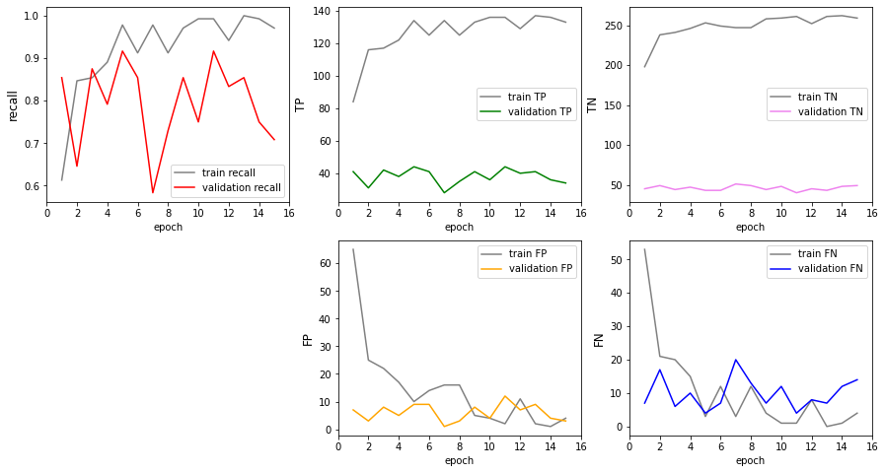
Model 2

Slide 24
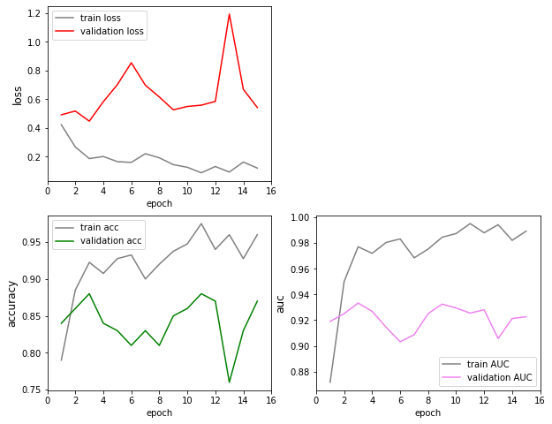
Model 3

Slide 25
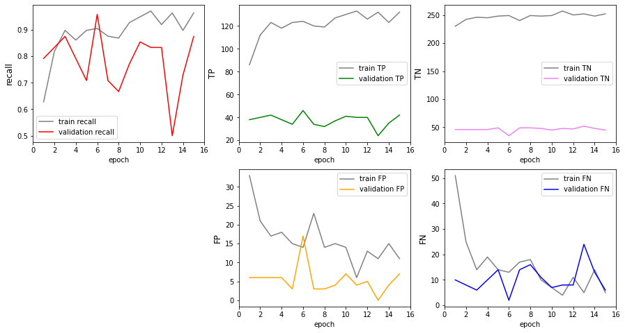
Model 3

Slide 26
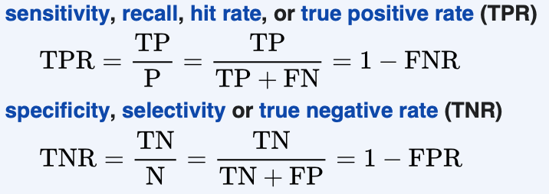
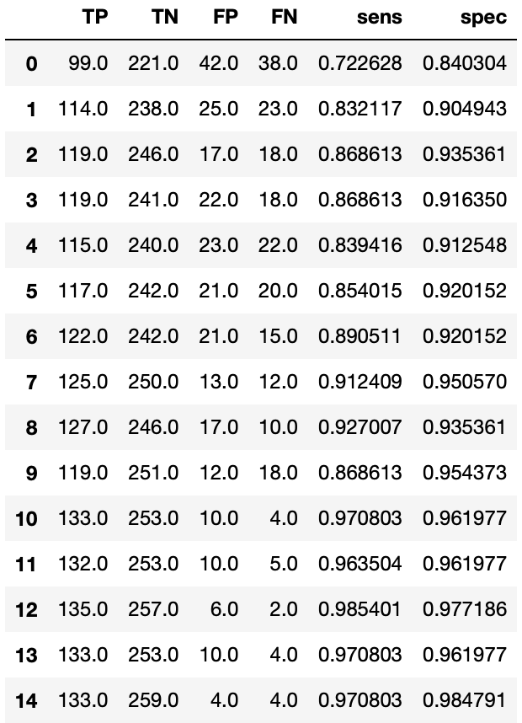
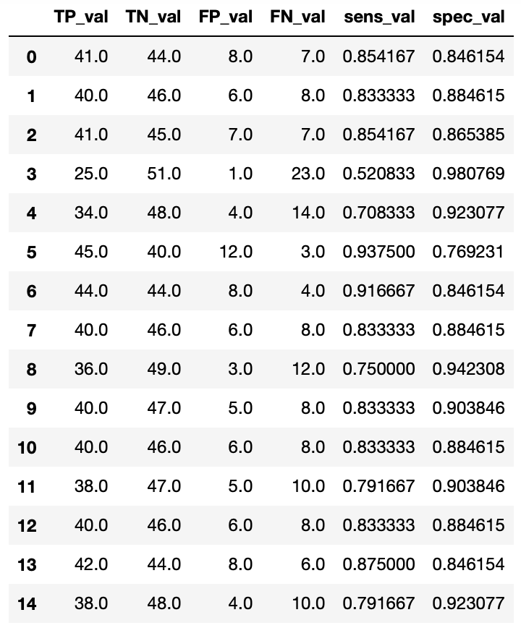
Model 1
Train
(Duke 400)
Validation
(Duke 100)
Validation:
Specificity was OK.
Sensitivity was bad
Solution:
increase power
Increase sample size

Slide 27
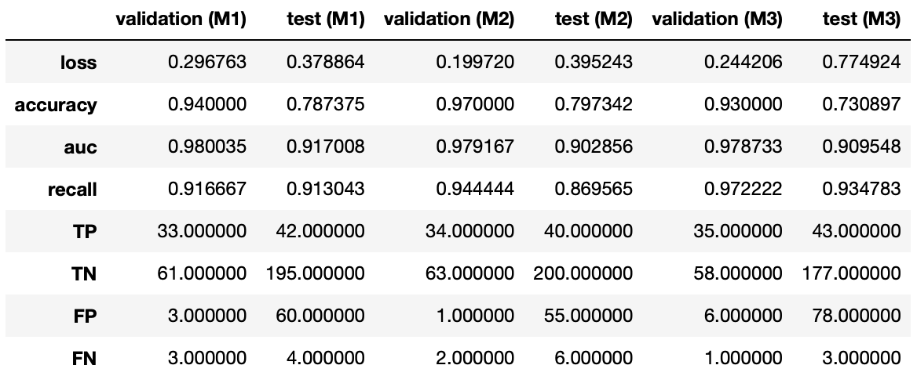
Test: Method 2 – Up-sample (on UAB)
Validation on Duke (100)
Test on UAB (301)
model1.save("VGG1_upsampling.h5")
model2.save("VGG2_upsampling.h5")
model3.save("VGG3_upsampling.h5")

Slide 28
Result 3. Method 3 – Interpolate an image
Model 1: a simple sequential model using only the VGG16 architecture
Model 2: add a few more dense layers
Model 3: add dropout and another fully connected layer

Slide 29
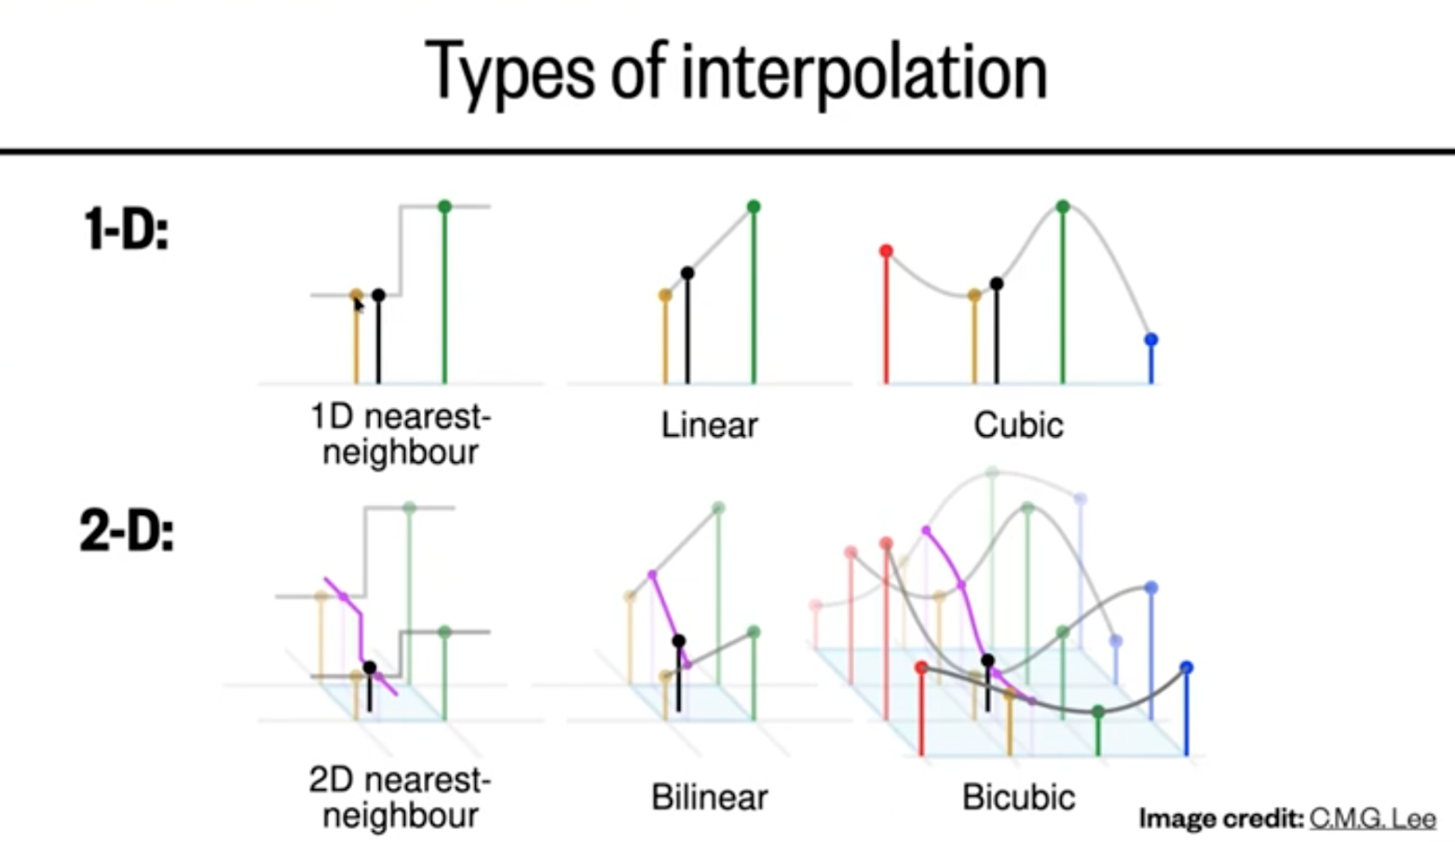
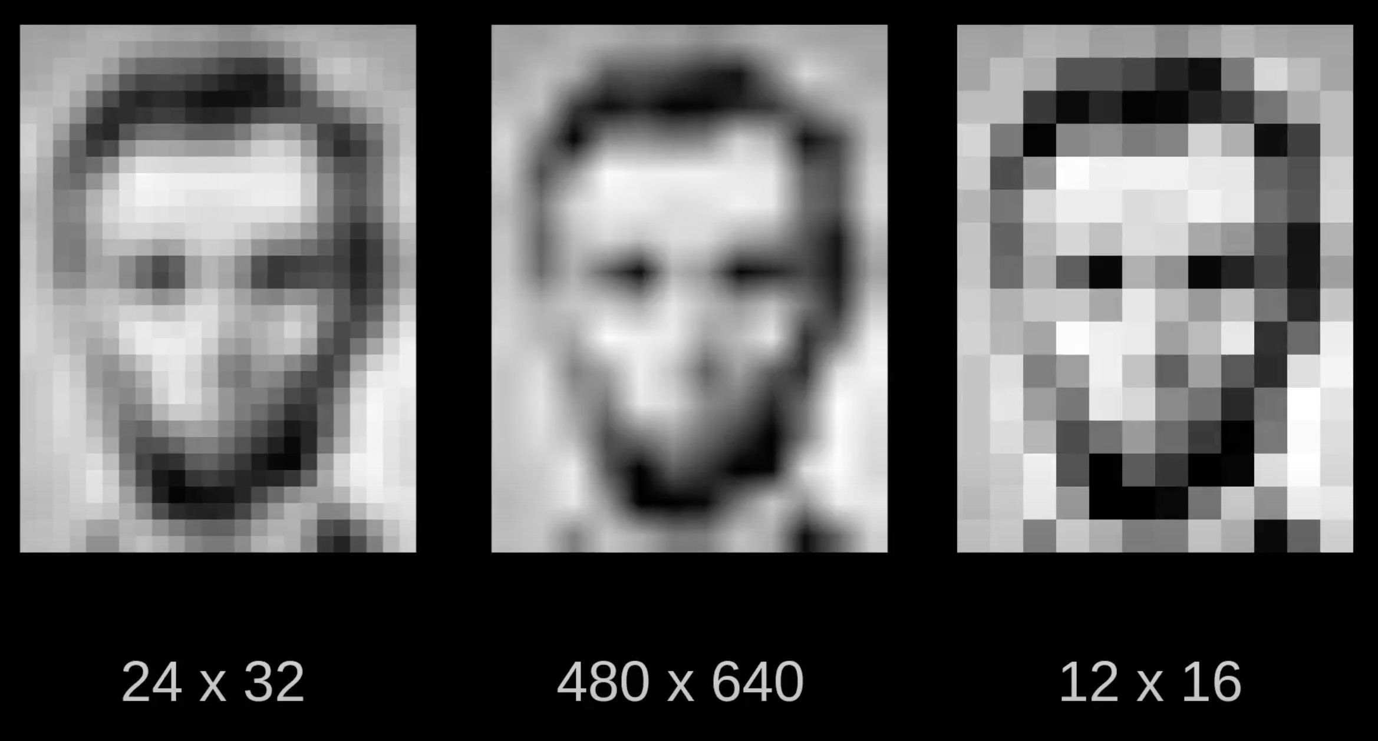
Image Processing
Bilinear Interpolation & Resampling

Slide 30
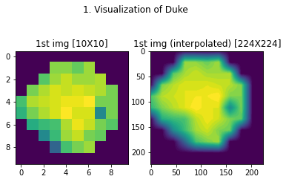
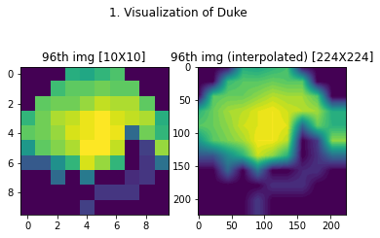
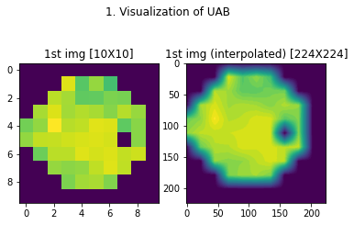
Visualization: - Original vs. Interpolated
Duke 24-2
Duke 30-2
UAB 24-2

Slide 31
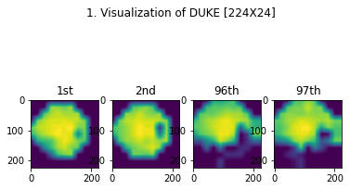
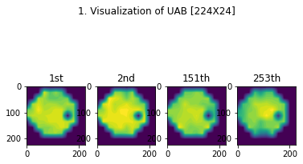
Visualization: Interpolated

Slide 32
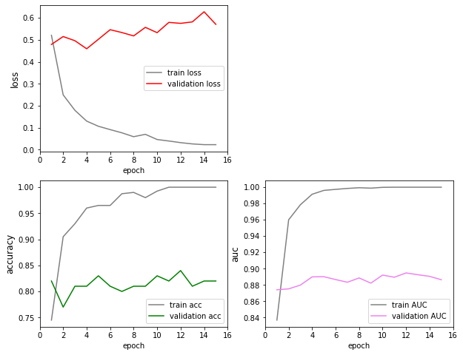
Model 1
Notes:
Model 1

Slide 33
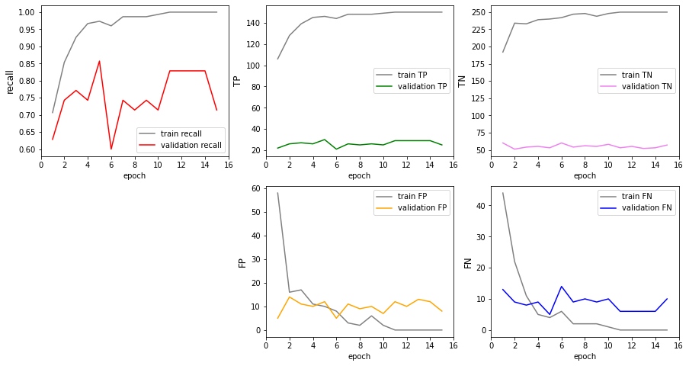
Model 1

Slide 34
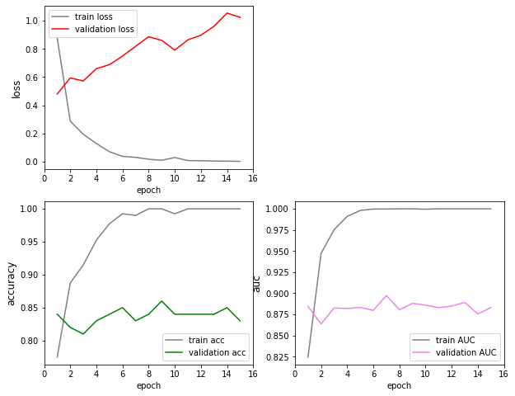
Model 2

Slide 35
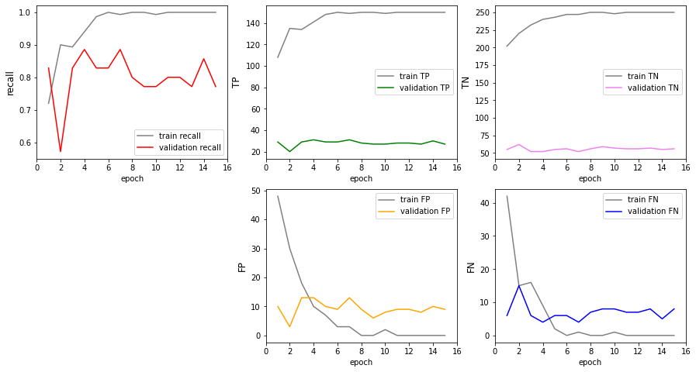
Model 2

Slide 36
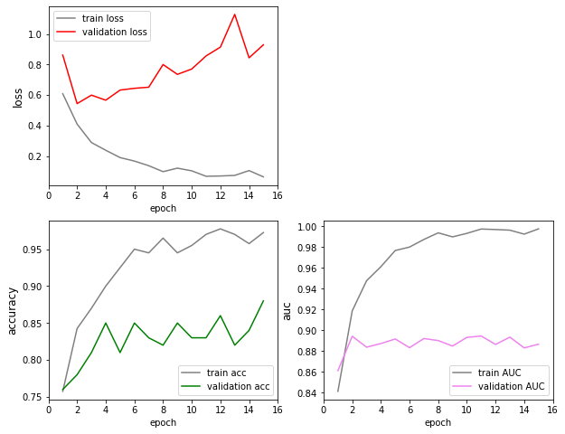
Model 3

Slide 37
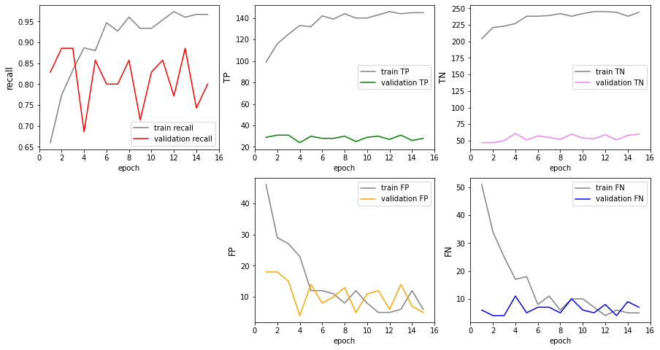
Model 3

Slide 38
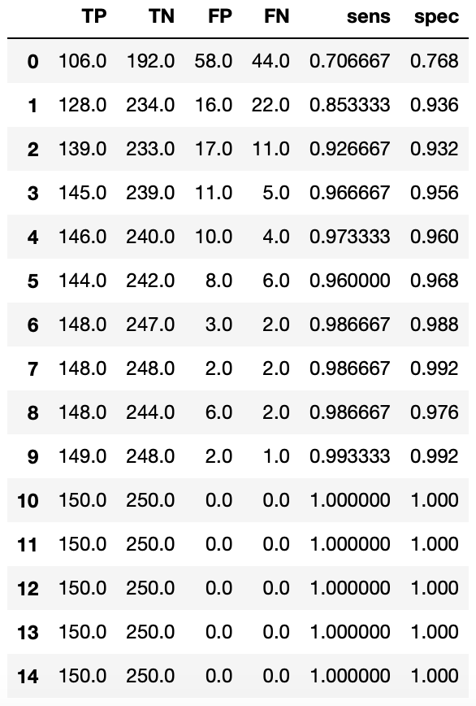
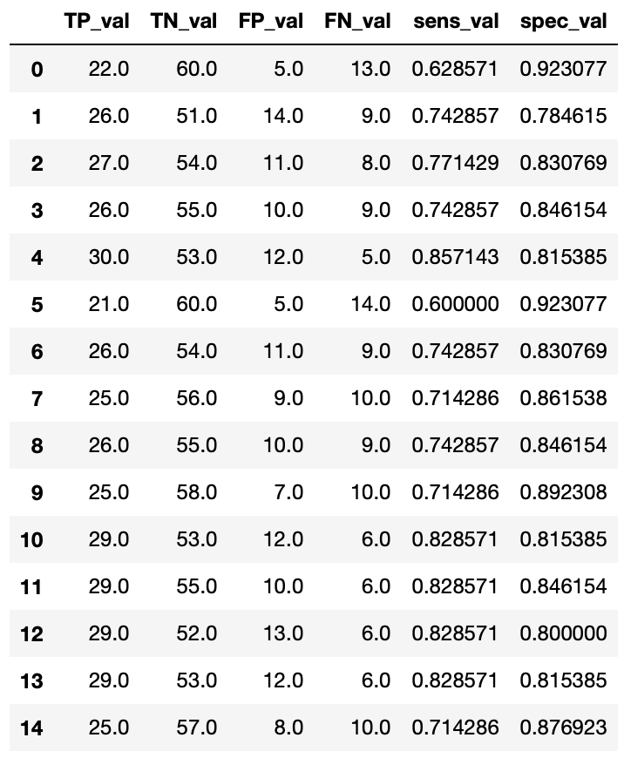
Model 1
Train
(Duke 400)
Validation
(Duke 100)
Validation:
Specificity was OK.
Sensitivity was bad
Solution:
increase power
Increase sample size

Slide 39
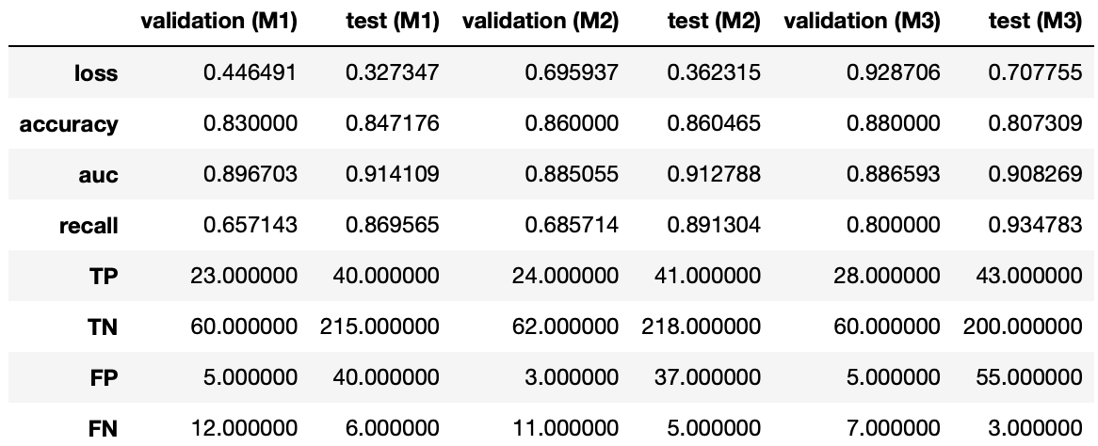
Test: Method 3 – Interpolating (on UAB)
Validation on Duke (100)
Test on UAB (301)
model1.save("VGG1_interpolating.h5")
model2.save("VGG2_interpolating.h5")
model3.save("VGG3_interpolating.h5")

Slide 40
Data backup
4 Folders:
Competitor Company_Yuhui 20220819
Duke project_python_Yuhui 20220819
UAB project_python_Yuhui 20220819
Zeiss PPT - work report_Yuhui 20220819
3 locations:
Network
OneDrive
Remote computer (desktop)

Slide 41
Future
1. Upsampling:
- Pad out 10X10 to 224X224 (with 0 or NaN) (done (1))
- Upsample smaller image (Keras) (done (3))
standard interpolator (scipy.interpolate.griddata — SciPy v1.9.0 Manual) (done (4))
2. Fine-tuning the transfer study of VGG16 (done (2))
Hyperparameter tuning: AutoML

